Slide 1




Fast Inverse Uncertainty Quantification via Deep Learning Surrogates
Filippo Zacchei,
Andrea Manzoni,
Attilio Frangi

Slide 2
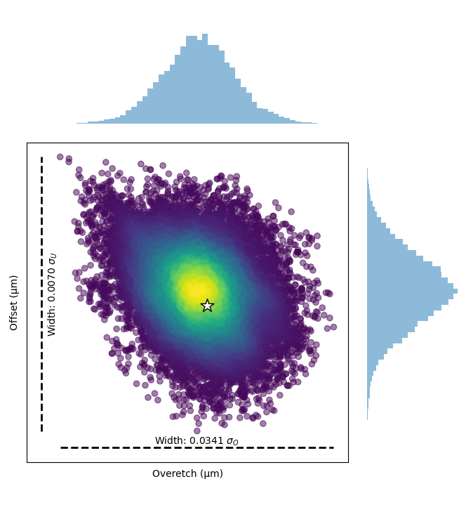
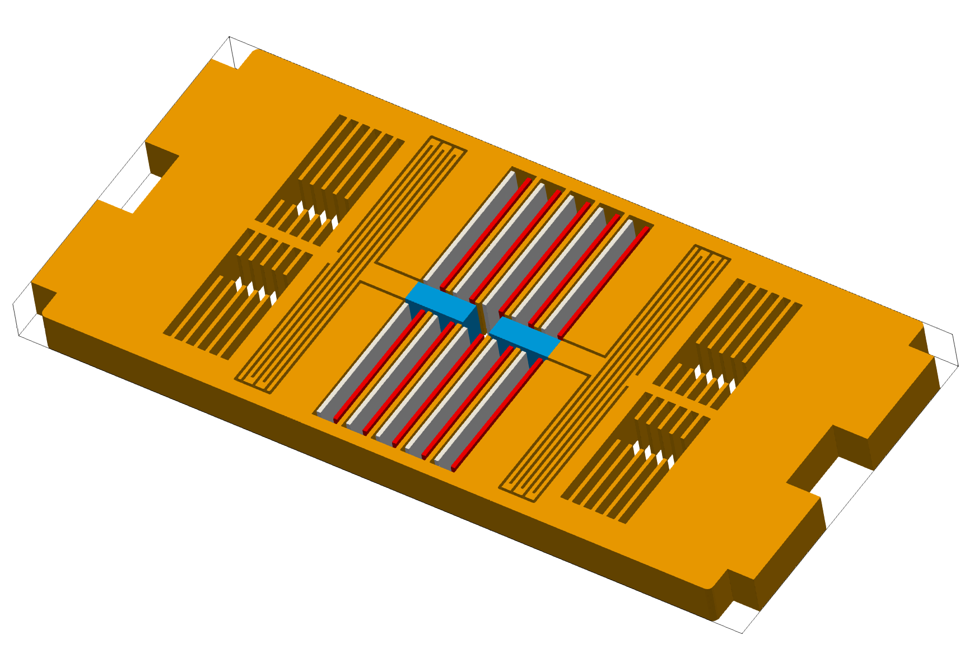
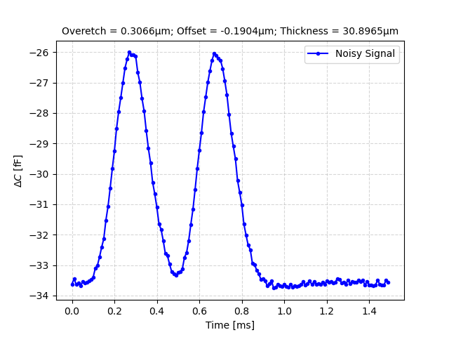
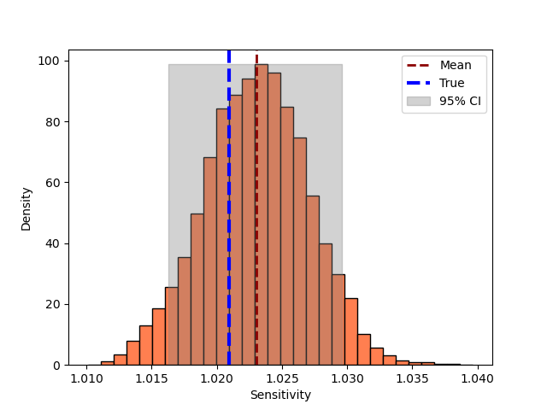
Backward Uncertainty quantification Framework
Collect
Measurements
Propagate Uncertainty for QoIs
1
3
Physical device:
uncertain parameters
Derive Posterior
Distributions
4
2
[1] Filippo Zacchei, Francesco Rizzini, Gabriele Gattere, Attilio Frangi, and Andrea Manzoni. Neural networks based surrogate modeling for efficient uncertainty quantification and calibration of mems accelerometers. International Journal of Non-Linear Mechanics, 167:104902, 2024.

Slide 3
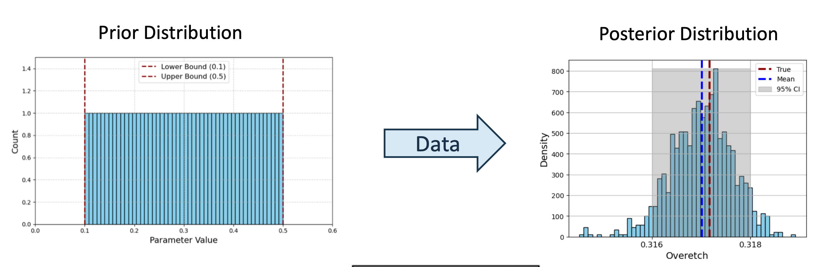
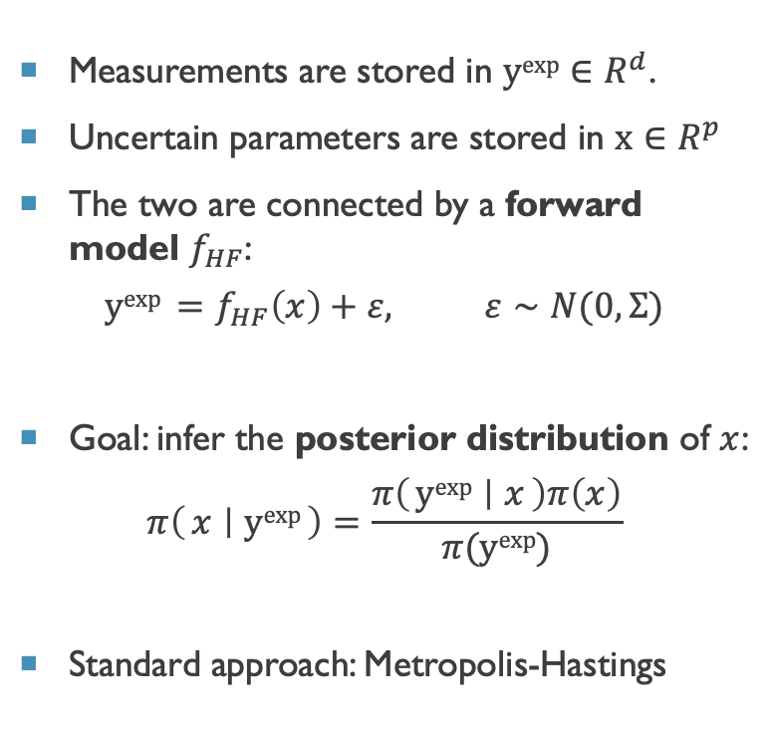
General Framework - Bayesian Inverse Problem
Measurements are stored in $yexp∈R^{d}$.
Uncertain parameters are stored in $x∈R^{p}$
The two are connected by a forward model $f_{HF}$:
$$yexp =f_{HF}\left(x\right)+ε, ε∼N(0,Σ)$$
Goal: infer the posterior distribution of $x$:
$$π\left(x ∣ yexp\right)=\frac{π\left(yexp ∣ x\right)π\left(x\right)}{π(yexp)}$$
Standard approach: Metropolis-Hastings

Slide 4


General Framework - Metropolis Hastings
Measurements are stored in $yexp∈R^{d}$.
Uncertain parameters are stored in $x∈R^{p}$
The two are connected by a forward model $f_{HF}$:
$$yexp =f_{HF}\left(x\right)+ε, ε∼N(0,Σ)$$
Goal: infer the posterior distribution of $x$:
$$π\left(μ ∣ yexp\right)=\frac{π\left(yexp ∣ x\right)π\left(x\right)}{π(yexp)}$$
Standard approach: Metropolis-Hastings
Accept/Reject Parameters
Evaluate Likelihood
Propose parameters
High Fidelity
Model
Data Driven Surrogate
[2] Benjamin Peherstorfer, Karen Willcox, and Max Gunzburger. Survey of multifidelity methods in uncertainty propagation, inference, and optimization. Siam Review,60(3):550–591, 2018.

Slide 5
Data Driven surrogates: computational budget
Online Cost: Inference
Use the High-Fidelity model only if it is fast, or employ a reduced-order model if sufficiently accurate.
Offline Cost: Data Generation
Train a fast surrogate model; requires a large dataset for accuracy.
Hybrid: Multi-Level / Online Learning
Combine data-driven models with computational solvers for improved efficiency and robustness.
Online
Hybrid
2
3
4
Offline
1

Slide 6
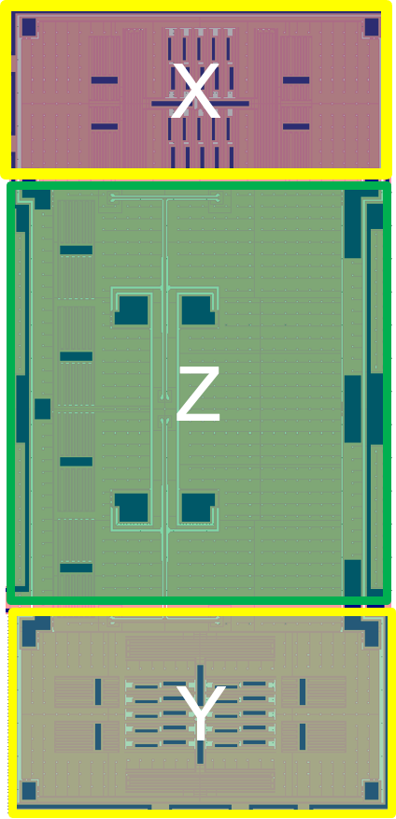
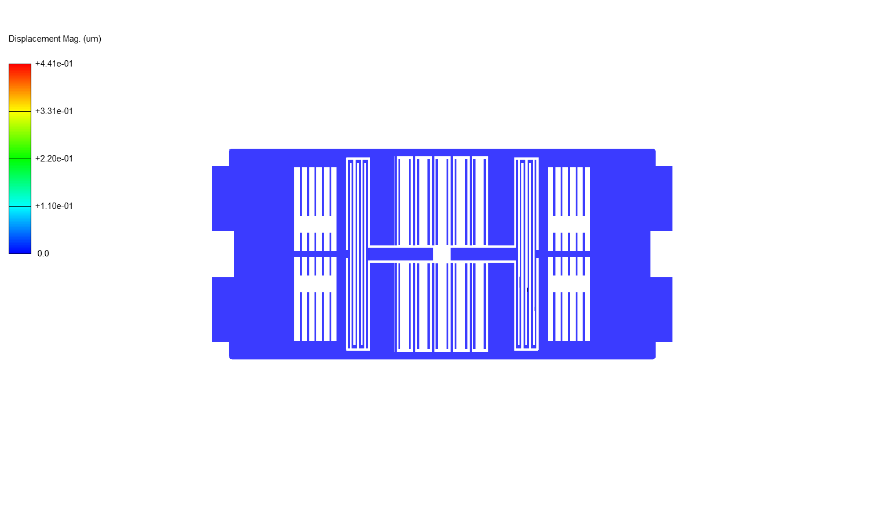
Neural networks based surrogate modeling for efficient uncertainty quantification and calibration of MEMS accelerometers Filippo Zacchei, Gabriele Gattere, Marco Rizzini, Andrea Manzoni, Attilio Frangi
I
1
Objective:
Perform electronic testing to efficiently determine device sensitivity and execute cheap yet accurate calibration.
Methodology:
Employ Deep Learning-based surrogate models with Markov Chain Monte Carlo sampling:
Develop high-fidelity simulations to generate benchmark data and identify the most effective calibration experiment.
Master the parameterization of the mapping process through the application of surrogate models.

Slide 7
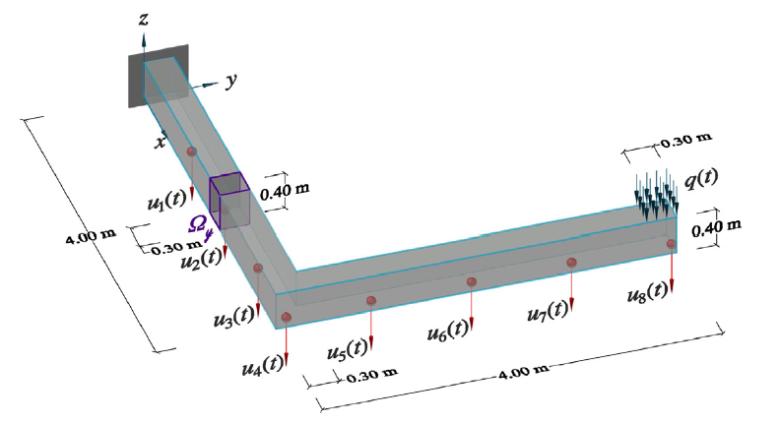
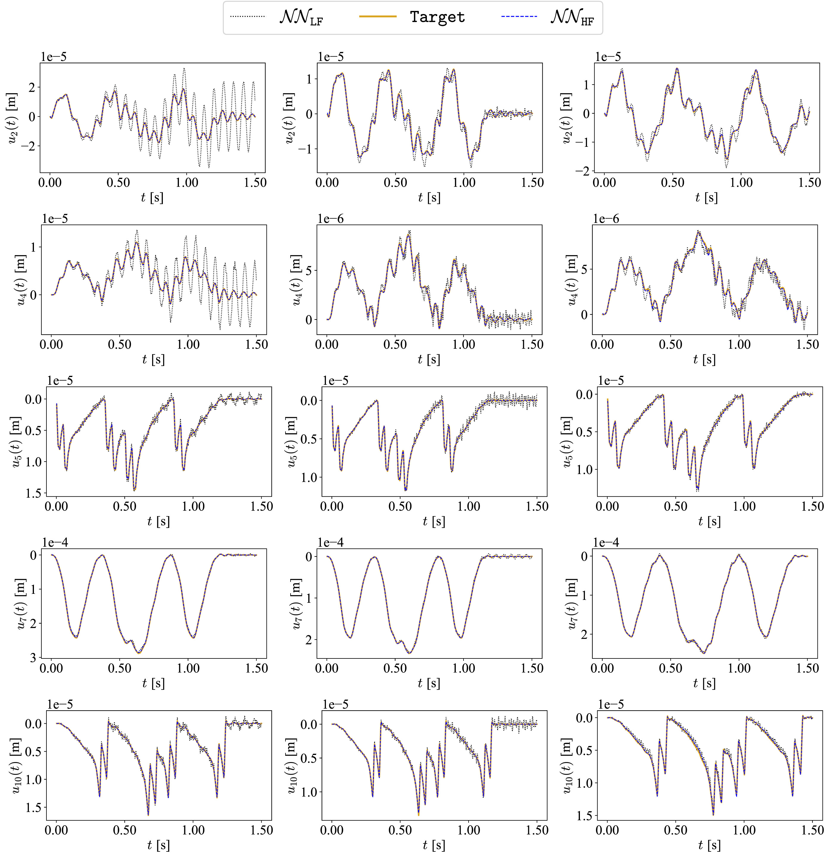
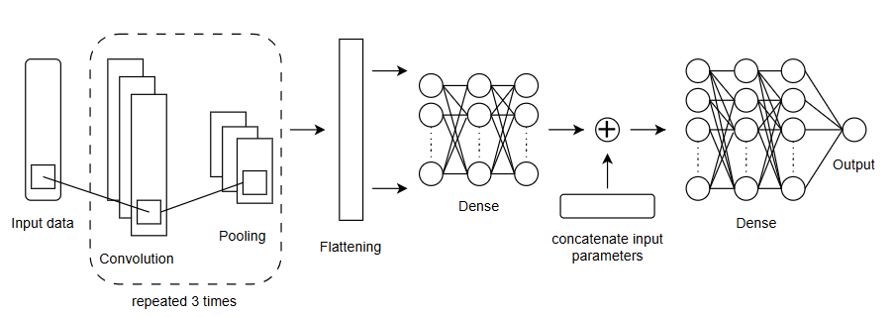
Accelerating Bayesian Inference in Structural Health Monitoring and Groundwater Flow Modeling through Log-Likelihood Surrogates Filippo Zacchei, Carlotta Francia, Matteo Torzoni, Andrea Manzoni
I
2
L-shaped Beam
High Dimensional Signal
Signal Compression for log-likelihood surrogate
Provides ton of information, but makes difficult to train a surrogate model

Slide 8
Multi-Fidelity Delayed Acceptance MCMC for Efficient Bayesian Inference
III
3
Benchmark: MLDA (Multi-Level Delayed Acceptance)
Proposed Algorithm: MFDA (Multi Fidelity Delayed Acceptance)
Challenges in High-Dimensional Sampling (i.e. high dimensional input/output)
We propose combining two complementary strategies:
1. Multi-Fidelity Filtering
(Multi-Level Delayed Acceptance MCMC)
2. Multi-Fidelity Fusion
(Multi-Fidelity Neural Networks)
[2] Benjamin Peherstorfer, Karen Willcox, and Max Gunzburger. Survey of multifidelity methods in uncertainty propagation, inference, and optimization. Siam Review,60(3):550–591, 2018.

Slide 9
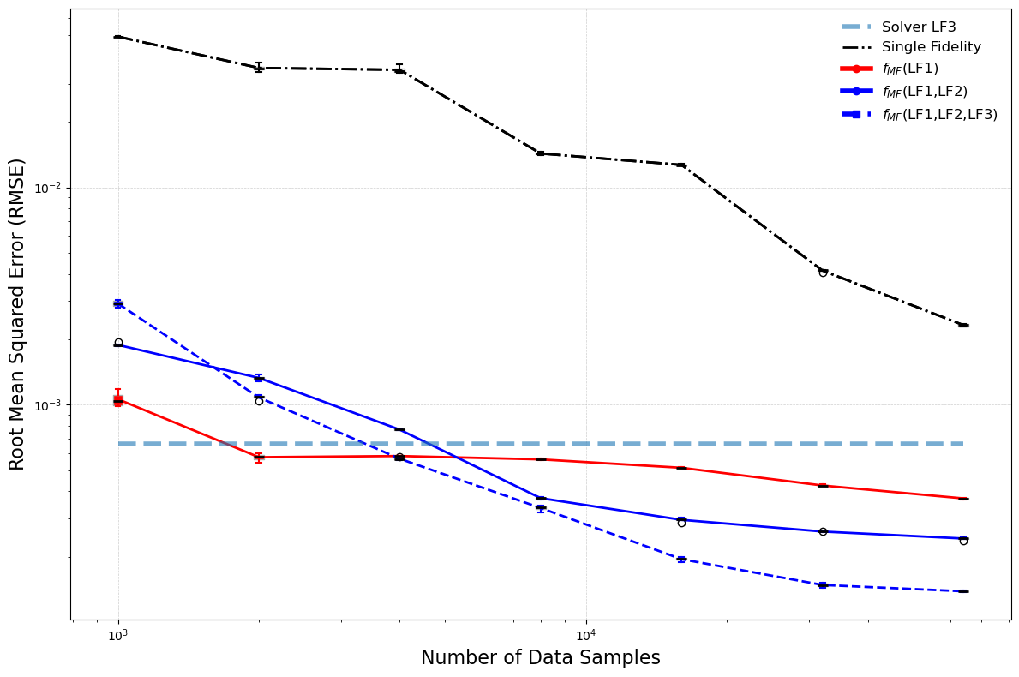
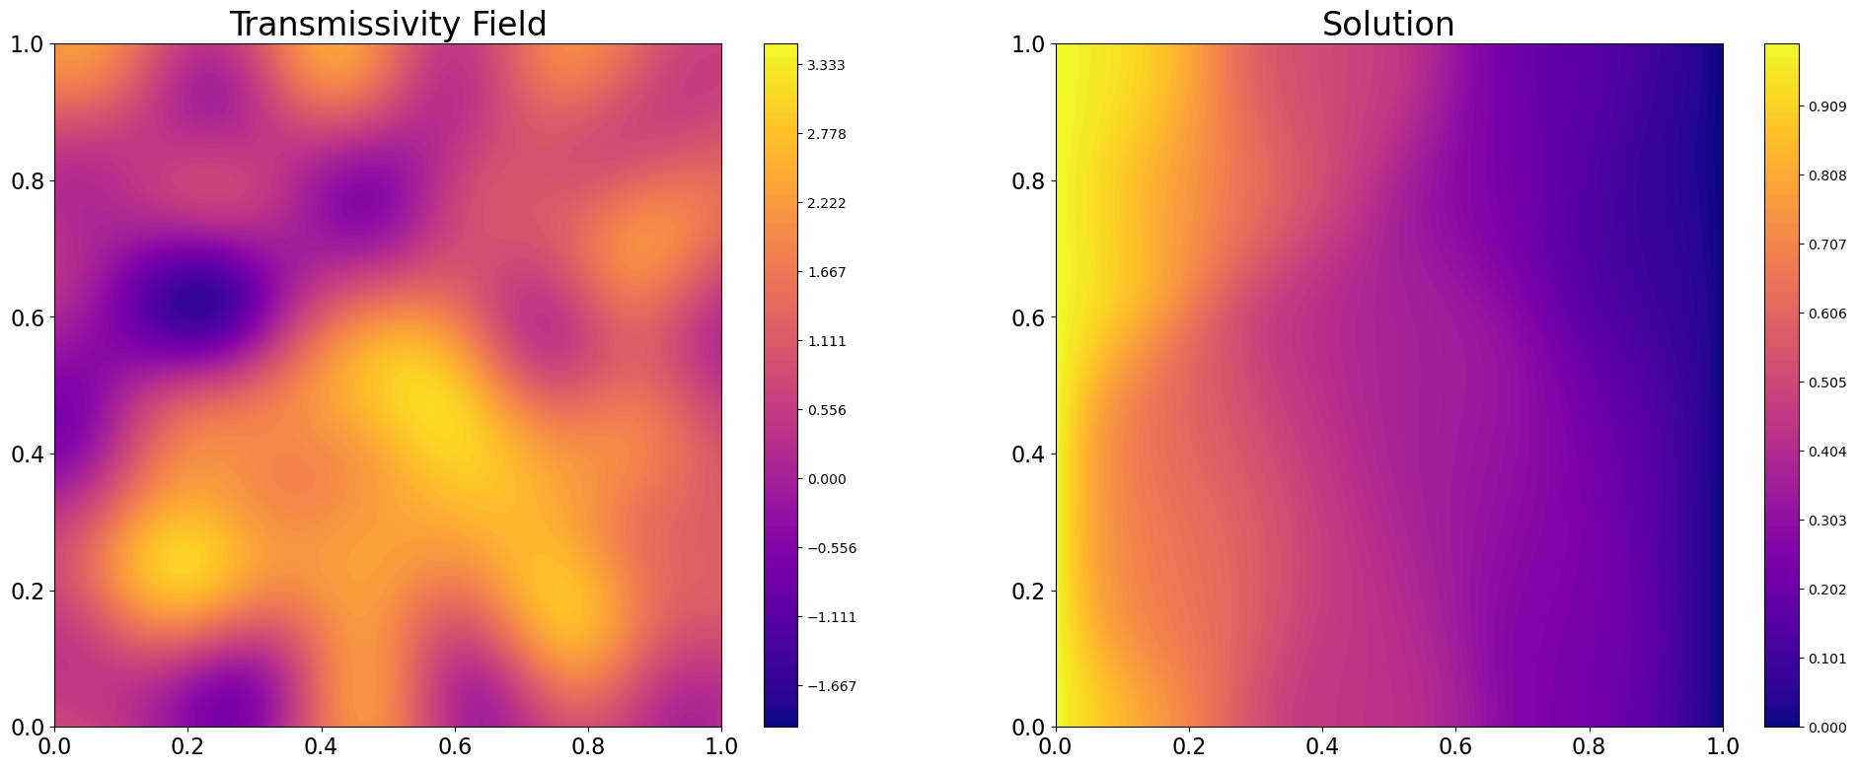
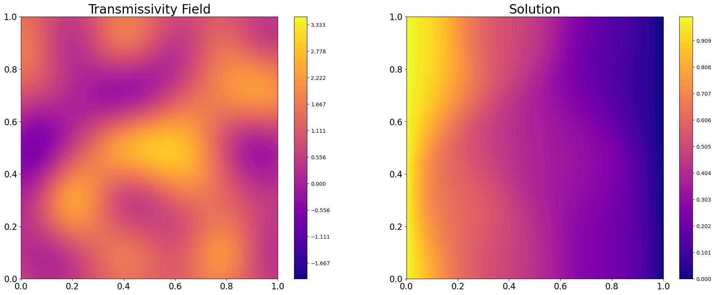
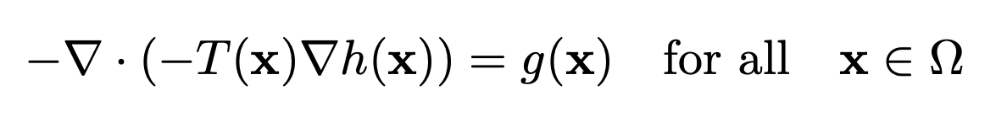
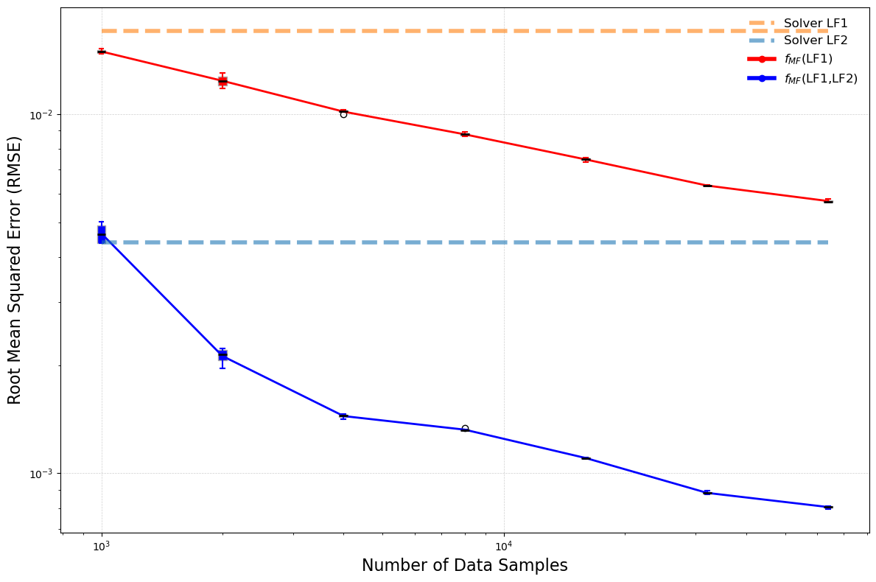
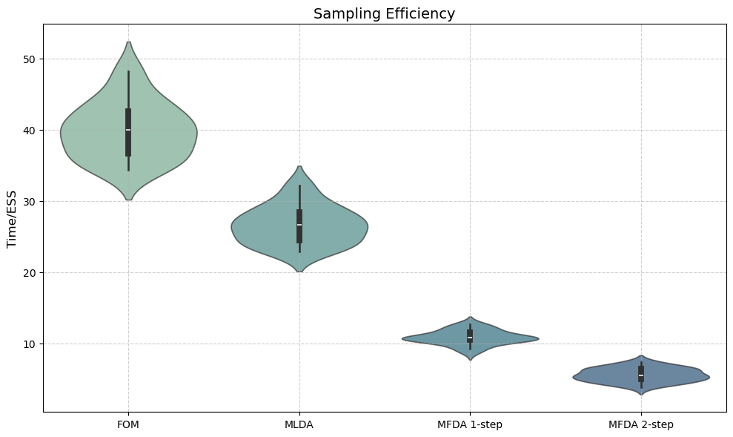
Results: groundwater flow transmissivity reconstruction
• Methodology validated on a benchmark groundwater flow problem with an unknown transmissivity field.
• Multi-Fidelity data generated through varying FEM discretizations.
Key Outcomes:
• Few forward-model training evaluations.
• Correct Field estimation
• Significant increase in sampling efficiency (5–10x speed-up compared to FOM).
Forward Accuracy
Backward Accuracy
True Field
FOM - MH
MFDA
RMSE = 0.768
RMSE = 0.769
Sampling Efficiency
[3] Lykkegaard, Mikkel Bue, et al. "Multilevel delayed acceptance MCMC." SIAM/ASA journal on uncertainty quantification 11.1 (2023): 1-30.

Slide 10
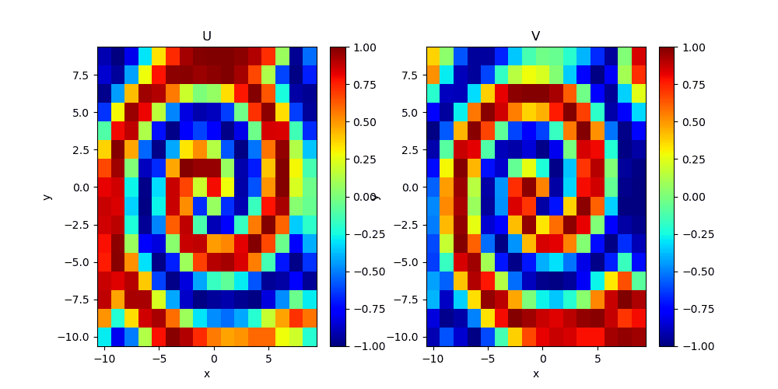
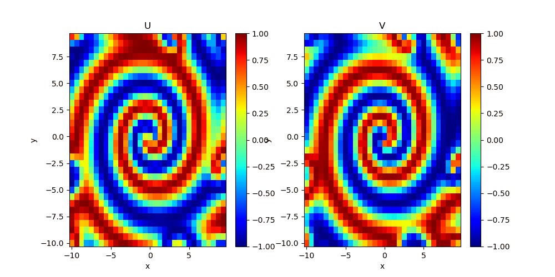
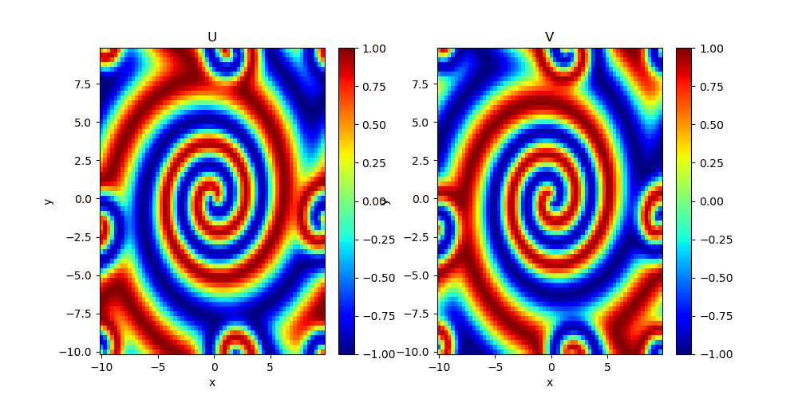
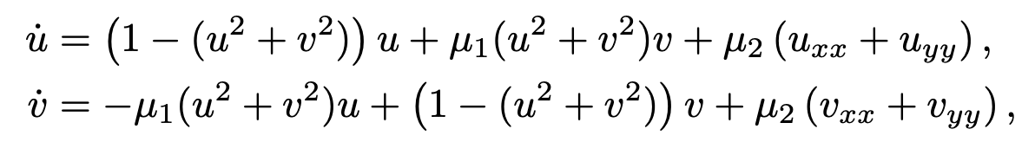
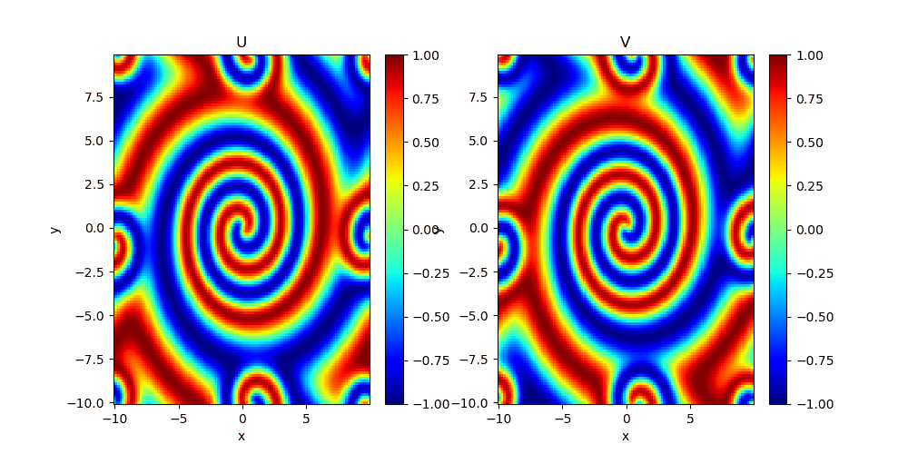
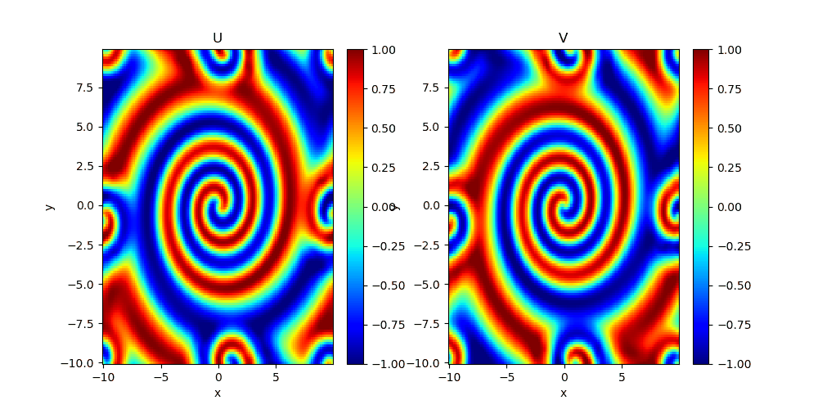
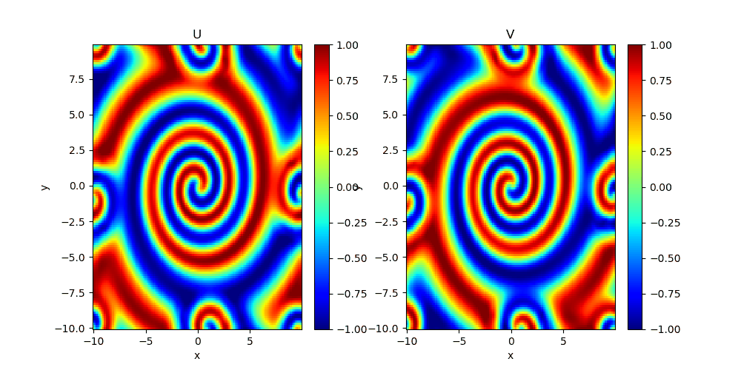

Results: reaction diffusion equation
LF1
LF2
LF3
HF data
MF1
MF2
MF3
[3] Lykkegaard, Mikkel Bue, et al. "Multilevel delayed acceptance MCMC." SIAM/ASA journal on uncertainty quantification 11.1 (2023): 1-30.

Slide 11


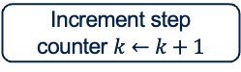

Gaussian Process Regression-Based Bayesian Inversion - Methodology
II
4
Proposed algorithm: Delayed Acceptance GP-Active Sampling
Given training data D = {X, y} and observation noise σₙ²,
the GP posterior at a test point x* is:
Mean prediction:
μ(x*) = k*ᵀ (K + σₙ² I)⁻¹ y
Predictive variance:
σ²(x*) = k(x*, x*) - k*ᵀ (K + σₙ² I)⁻¹ k*
Start: Initialize GP and MCMC
Propose new $θ′$
Evaluate GP likelihood
Accept at GP level?
Yes
Evaluate FOM likelihood
No
Accept at HF level?
Repeat $θ$ old in the chain
No
✅ Error Quantification is directly embedded
✅ Data Efficiency: possible thanks to efficient online update
⛔️ Difficult to scale to high dimension
Yes
Increment step counter $k←k+1$
Add $θ$’ to the chain
Woodbury Identity
No
k % k_{train} =0?
Yes
Add Sample, retrain GP
Yes
Is GP_{std} negligible?
Switch to GP-only MCMC

Slide 12
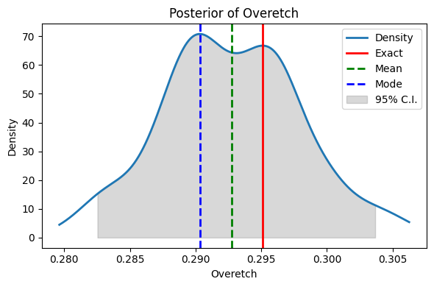
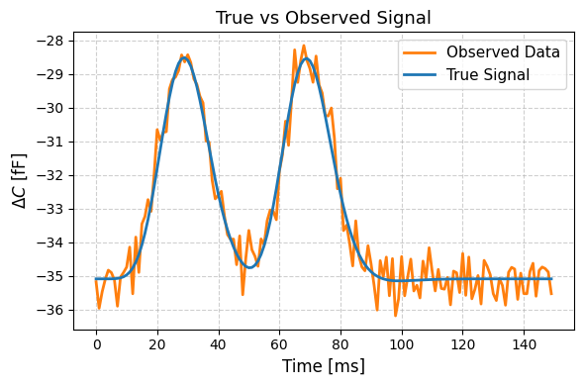
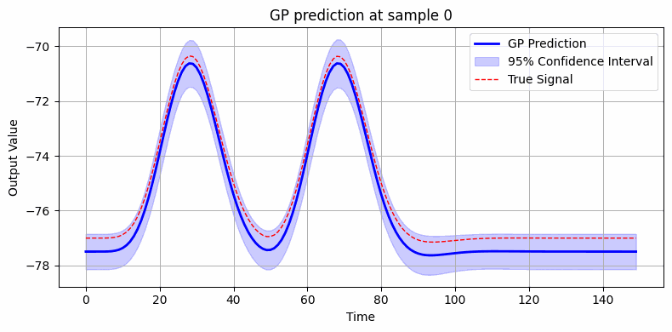
Gaussian Process Regression-Based Bayesian Inversion - Results
II
• Signal compression: Proper Orthogonal Decomposition (POD) retaining the first 5 modes.
• Surrogate modeling: Independent Gaussian Processes (GPs) trained to predict each POD coefficient.
Training approach:
• Initial phase: 50 high-fidelity (HF) signals.
• Adaptive phase: Approximately 50 additional signals collected online.
• Computational efficiency: Total reduction of HF evaluations by approximately 10x.

Slide 13
Summary
Gaussian Process Regression vs Neural Networks: a comparison
 | GPR | NNs
Embed UQ | ✅ | ⛔️ (✅)
Online Learning | ✅ | ⛔️
Robust to Overfitting | ✅ | ⛔️
Curse of Dimensionality | ⛔️ | ✅
Scalability to Big Dataset | ⛔️ | ✅
Is it possible to combine the benefits of the two approaches?

Slide 14
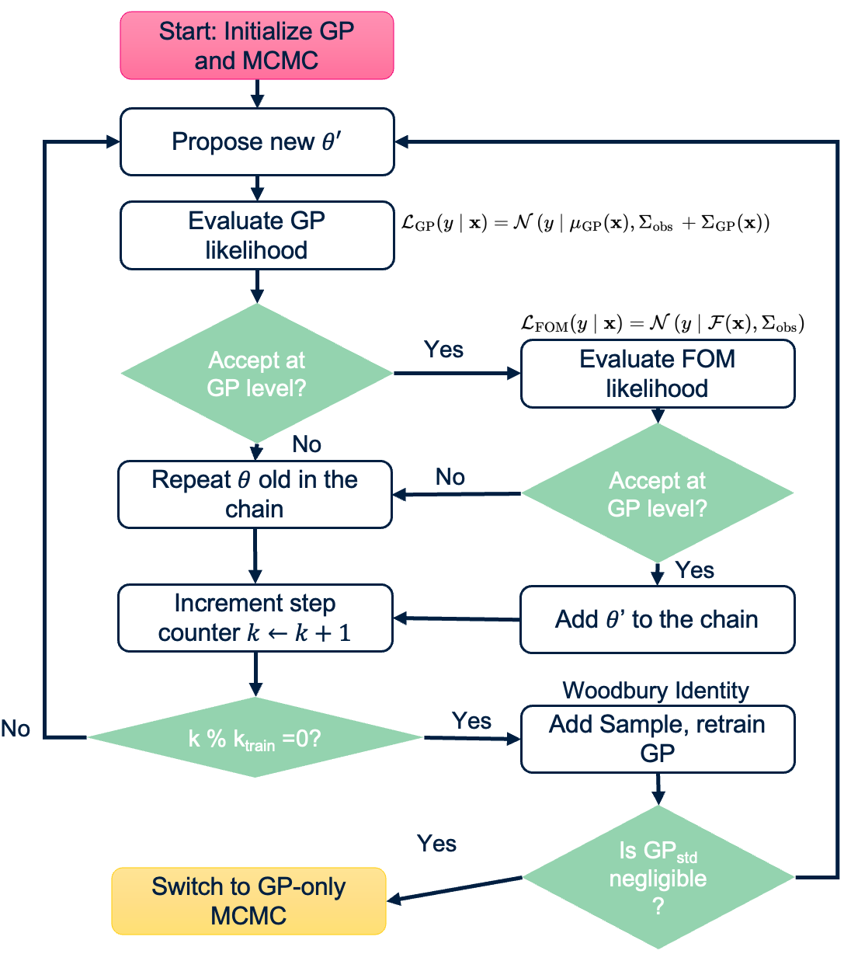
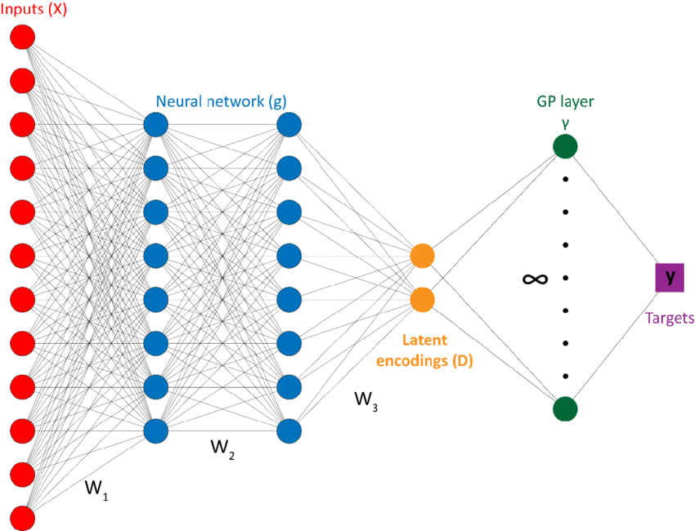
Integration of MFDA and GPR within a Global Active Learning Framework
What’s next?
IV
Comprehensive Methodology
Problem:
For complex models, learn a DL surrogate is generally data hungry
Training is performed by sampling from prior uninformed distribution.
Idea:
Leverage the ability of Neural Networks to learn multi-fidelity data using Deep Kernel Learning.
Rely on a final layer of Gaussian Process to refine the predictions online.
Interpret MFDA as an active sampling method to efficiently generate training data.
[4] Wilson, Andrew Gordon, et al. "Deep kernel learning." Artificial intelligence and statistics. PMLR, 2016.

Slide 15
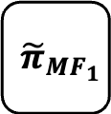
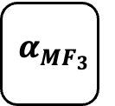
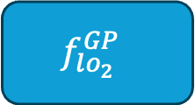
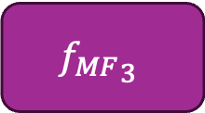
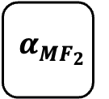

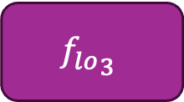
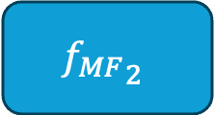
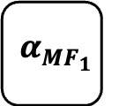

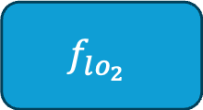
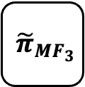
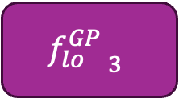
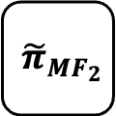
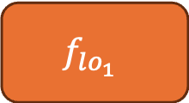
Surrogate Solver
Multi-Fidelity NN
$$f_{lo_{1}}^{ GP}$$
$${{f_{MF}}_{1}^{ }}_{ }$$
$${\tilde{π}}_{{MF}_{1}}$$
$${{α_{{MF}_{1}}^{ }}_{ }}_{ }$$
$$f_{lo_{1}}^{ }$$
$$f_{lo_{2}}^{GP }$$
$${f_{MF}}_{2}^{ }$$
$${\tilde{π}}_{{MF}_{2}}$$
$${{α_{{MF}_{2}}^{ }}_{ }}_{ }$$
$$f_{lo_{2}}^{ }$$
$${f_{lo}^{GP }}_{3}$$
$${f_{MF}}_{3}^{ }$$
$${\tilde{π}}_{{MF}_{3}}$$
$${{α_{{MF}_{3}}^{ }}_{ }}_{ }$$
$${f_{lo}^{ }}_{3}$$

Slide 16
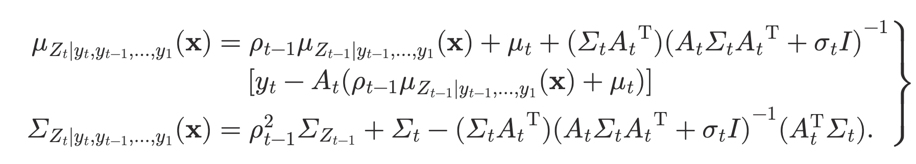
Idea: input surrogate (with UQ)
auto-regressive co-kriging scheme of Kennedy & O'Hagan:
If the datasets have a nested structure:
Perdikaris, P., Venturi, D., Royset, J. O., & Karniadakis, G. E. (2015). Multi-fidelity modelling via recursive co-kriging and Gaussian–Markov random fields. Proceedings of the Royal Society A: Mathematical, Physical and Engineering Sciences, 471(2179), 20150018.

Slide 17

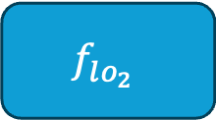
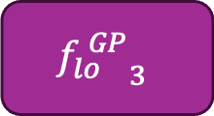
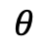
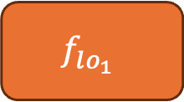
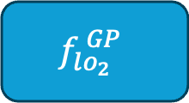
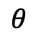




Co-Kriging Surrogate
$$f_{lo_{1}}^{ }$$
$$f_{lo_{1}}^{ GP}$$
How can we efficiently insert it in MFDA?
How can we train it?
$$θ$$
$$≈$$
$$θ$$
$$f_{lo_{2}}^{ }$$
$$f_{lo_{2}}^{ GP}$$
$$θ$$
$$≈$$
$$θ$$
$${f_{lo}^{ }}_{3}$$
$${f_{lo}^{ GP}}_{3}$$
$$θ$$
$$≈$$
$$θ$$

Slide 18



1. UQ-based surrogate choice
UQ will become higher for higher levels (less data)
Is Uncertainty low?
$$f_{lo_{2}}^{ GP}$$
$$θ$$
No
$$f_{lo_{2}}^{ }$$
$$θ$$

Slide 19
2. Training: online learning
UQ will become higher for higher levels (less data)
Is Uncertainty low?
$$f_{lo_{2}}^{ GP}$$
$$θ$$
No
$$f_{lo_{2}}^{ }$$
$$θ$$
Online Learning

Slide 21



Neural networks based surrogate modeling for efficient uncertainty quantification and calibration of MEMS accelerometers
Appendix
Obtained Results:
Accurate identification of unknown parameters with errors less than 1%.
Comprehensive forward and backward uncertainty quantification.
Efficient calibration of device (under 2 minutes) which can be further accelerated.
Limitations:
The process is data hungry: a huge number of HF simulations is needed to ensure good accuracy.
Difficult scalability, when then input-output relations becomes complex, the approach is not replicable.
Lack of interpretability
[1] Zacchei, F., Rizzini, F., Gattere, G., Frangi, A., Manzoni, A., “Neural networks based surrogate modeling for efficient uncertainty quantification and calibration of MEMS accelerometers”, International Journal of Non-Linear Mechanics, special issue: “Uncertainties in Nonlinear Mechanics of Solids and Structures”, February 2024.

